Slide 1
Information Extraction
Sudeshna Sarkar
10 Oct 2019
Slides adapted from those by Jurafsky, Mooney and Niranjan Balasubramaniam

Slide 2
What is Information Extraction?
Documents
Un-structured
(semi-structured)
Structured Databases
(aka Knowledge Bases)
Identify specific pieces of structured information (data) in a unstructured or semi-structured textual document.
Transform unstructured information in a corpus of documents or web pages into a structured database.
Applications
Newspaper articles
Web pages
Scientific articles
Newsgroup messages
Classified ads
Medical notes

Slide 3
Why IE
Clear factual information is helpful
Answer questions.
Analytics.
Organize and present information
Info boxes in Wikipedia
Obtain new knowledge via inference.
Works-for(x, y) AND located-in(y, z) → lives-in(x, z)

Slide 4
Information Extraction Tasks
Entity Recognition
Relation Extraction
Event Extraction

Slide 5
Named Entity Recognition
At the heart of the Giuliani-led critique of the president’s patriotism is the suggestion that Barack Obama has never expressed love for the United States. Rudolph W. Giuliani, the former mayor of New York City, has even challenged the media to find examples of Mr. Obama expressing such affection.
Has the president done so? Yes, he has.
A review of his public remarks provides multiple examples. In 2008, when he was still a presidential candidate, Mr. Obama uttered the magic words in Berlin, during a speech to thousands. Mr. Obama used a similar construction, as president, in 2011, during a town hall meeting in Illinois, when he recalled “why I love this country so much.”
Mr. Giuliani told Fox News that “I don’t hear from him what I heard from Harry Truman, what I heard from Bill Clinton, what I heard from Jimmy Carter, which is these wonderful words about what a great country we are, what an exceptional country we are.”

Slide 6
Relation Extraction
Located-in(Person, Place)
He was in Tennessee
Subsidiary(Organization, Organization)
XYZ, the parent company of ABC
Related-to(Person, Person)
John’s wife Yoko
Founder(Person, Organization)
Steve Jobs, co-founder of Apple...

Slide 7

Event Extraction

Slide 8
Sample Job Posting
Subject: US-TN-SOFTWARE PROGRAMMER
Date: 17 Nov 1996 17:37:29 GMT
Organization: Reference.Com Posting Service
Message-ID: <56nigp$mrs@bilbo.reference.com>
SOFTWARE PROGRAMMER
Position available for Software Programmer experienced in generating software for PC-Based Voice Mail systems. Experienced in C Programming. Must be familiar with communicating with and controlling voice cards; preferable Dialogic, however, experience with others such as Rhetorix and Natural Microsystems is okay. Prefer 5 years or more
experience with PC Based Voice Mail, but will consider as little as 2 years. Need to find a Senior level person who can come on board and pick up code with very little training.
Present Operating System is DOS. May go to OS-2 or UNIX in future.
Please reply to:
Kim Anderson
AdNET
(901) 458-2888 fax
kimander@memphisonline.com
Subject: US-TN-SOFTWARE PROGRAMMER
Date: 17 Nov 1996 17:37:29 GMT
Organization: Reference.Com Posting Service
Message-ID: <56nigp$mrs@bilbo.reference.com>
SOFTWARE PROGRAMMER
Position available for Software Programmer experienced in generating software for PC-Based Voice Mail systems. Experienced in C Programming. Must be familiar with communicating with and controlling voice cards; preferable Dialogic, however, experience with others such as Rhetorix and Natural Microsystems is okay. Prefer 5 years or more
experience with PC Based Voice Mail, but will consider as little as 2 years. Need to find a Senior level person who can come on board and pick up code with very little training.
Present Operating System is DOS. May go to OS-2 or UNIX in future.
Please reply to:
Kim Anderson
AdNET
(901) 458-2888 fax
kimander@memphisonline.com

Slide 9
Extracted Job Template
computer_science_job
id: 56nigp$mrs@bilbo.reference.com
title: SOFTWARE PROGRAMMER
salary:
company:
recruiter:
state: TN
city:
country: US
language: C
platform: PC \ DOS \ OS-2 \ UNIX
application:
area: Voice Mail
req_years_experience: 2
desired_years_experience: 5
req_degree:
desired_degree:
post_date: 17 Nov 1996

Slide 10
Named Entity Recognition
Usually a preprocessing step for subsequent task-specific IE, or other tasks such as question answering.
people places organizations
U.S. Supreme Court quashes 'illegal' Guantanamo trials
Military trials arranged by the Bush administration for detainees at Guantanamo Bay are illegal, the United States Supreme Court ruled Thursday. The court found that the trials — known as military commissions — for people detained on suspicion of terrorist activity abroad do not conform to any act of Congress. The justices also rejected the government's argument that the Geneva Conventions regarding prisoners of war do not apply to those held at Guantanamo Bay. Writing for the 5-3 majority, Justice Stephen Breyer said the White House had overstepped its powers under the U.S. Constitution. "Congress has not issued the executive a blank cheque," Breyer wrote.
President George W. Bush said he takes the ruling very seriously and would find a way to both respect the court's findings and protect the American people.

Slide 11
Relation Extraction
Once entities are recognized, identify specific relations between entities
Employed-by
Located-at
Part-of
Example:
Michael Dell is the CEO of Dell Computer Corporation and lives in Austin Texas.

Slide 12
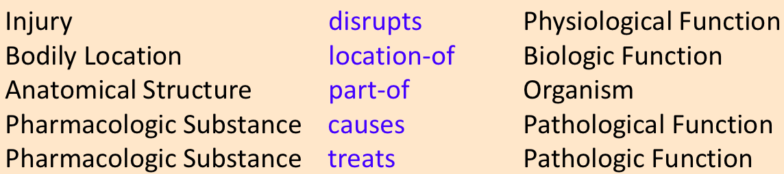
Medical Relations
UMLS Resource

Slide 13
Why is relation extraction difficult?
Linguistic variability
President Barack Obama
President of the United States, Mr. Obama, …
Entity Ambiguity
Apple produces seeds vs. Apple produces iPhones.
Implicit Relations
Obama met with Putin in Moscow => Obama traveled to Moscow.
Complex language with many clauses, long list of qualifiers, negations etc.
Pentoxifylline (PTX) affects many processes that may contribute to the pathogenesis of severe malaria and it has been shown to reduce the duration of coma in children with cerebral malaria.

Slide 14
How is relation extraction done?
Pattern-based + Bootstrapping
Supervised Relation Extraction
Distantly Supervised Relation Extraction
Open Information Extraction

Slide 15
Pattern-based Extraction
Inspect sentences that express relation.
Write lexical patterns that suggest relation.

Slide 16
Pattern-based IS-A relations
Suppose you want to find IS-A relations.
You can look for sentences that contain: x is a y.
Inspect some sentences.
Agar is a substance prepared from a mixture of red algae, such as Gelidium. This includes temples, treasuries, and other important civic buildings. Insurance does not cover bruises, wounds, broken bones or other injuries. The bow lute, such as the Bambara ndang, are widely used here.

Slide 17
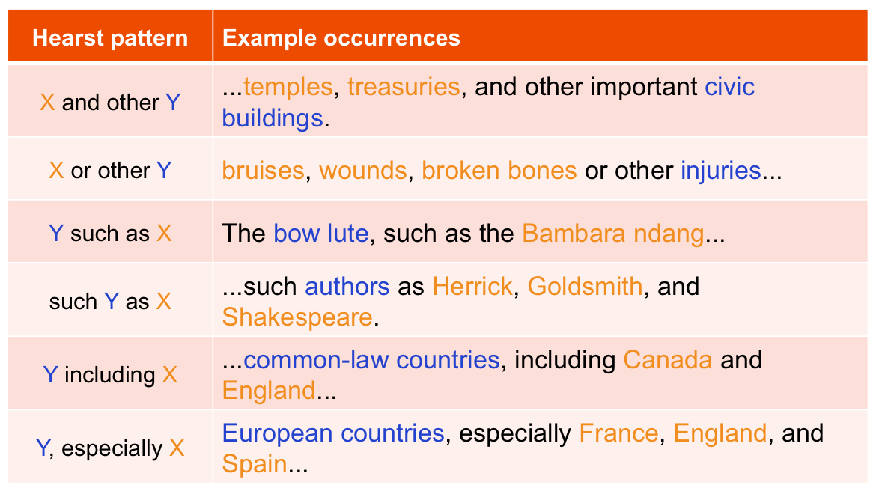
Hearst Hyponym Patterns
66% accurate. Coverage?

Slide 18
Meronym (part-whole) patterns
Berland and Charniak patterns
Find all sentences in a corpus containing basement and building
Sentence Fragment | Pattern
... building’s basement … | whole NN[-PL] ’s POS part NN[-PL]
…basement of building… | parts NN-PL of PREP wholes NN-PL
…basement in building… | parts NN-PL in PREP wholes NN-PL
…basement in the big building… | part NN in PREP {the|a} DET mods [JJ|NN]* whole NN
…basements of a building… | part NN[-PL] of PREP {the|a} DET mods [JJ|NN]* whole NN
For each pattern:
1. Find occurrences of the pattern
2. Filter those ending with -ing, -ness, -ity
3. Applied a likelihood metric.
First two are reliable patterns.
The rest are noisy in practice. (~ 55% accuracy)

Slide 19
Bootstrapping for Relation Extraction: Automate Pattern Extraction
Take some seed relations.
e.g., Buried-in(Mark Twain, Elmira)
Find some sentences that contain the seed entities and extract patterns.
Mark Twain is buried in Elmira, NY. → X is buried in Y The grave of Mark Twain is in Elmira → The grave of X is in Y Elmira is Mark Twain’s final resting place → Y is X’s final resting place
Use these patterns to extract new relations.
The grave of Bruce Lee is in Seattle. → Buried-in(Bruce Lee, Seattle)

Slide 20
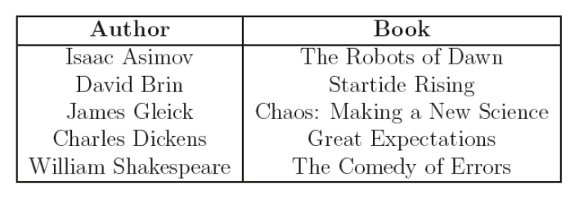
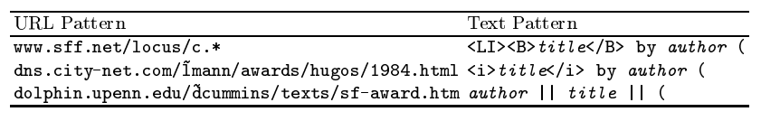
Authors of Books: DIPRE [Brin 1998]
Extract (author, book) pairs Start with these 5 seeds:
Learn patterns
Iterate:
Use patterns to get more instances
Use instances to get more patterns
Extracted 15,000 author-book pairs with 95% accuracy with just three iterations.

Slide 21
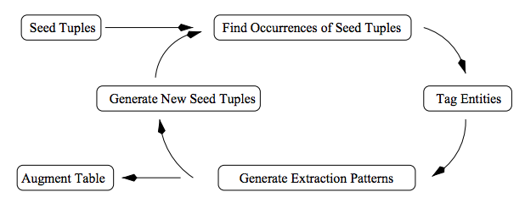
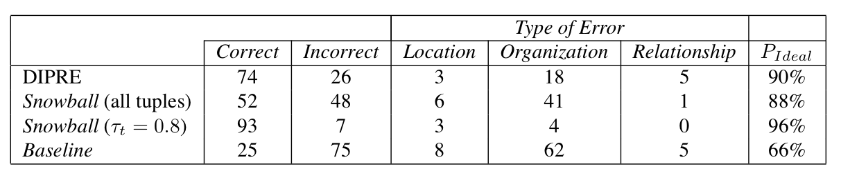
Snowball: Improved Bootstrapping [Agichten and Gravano, 2000]
Add constraints on X and Y
e.g. has to be named entities.
Add heuristics to score extractions, select best ones at each iteration.

Slide 22
Issues with Bootstrapping
Requires seeds for each relation.
Sensitive to original set of seeds.
Semantic drift at each iteration.
Some patterns may extract noisy or different relation e.g.US Presidents “presidents such as...” → Company presidents
Precision tends to be not that high
No probabilistic interpretation
Hard to know how confident to be in each result

Slide 23
How is relation extraction done?
Pattern-based + Bootstrapping
Supervised Relation Extraction
Distantly Supervised Relation Extraction
Open Information Extraction
Event Extraction

Slide 24
Supervised Relation Extraction [Zhou et al, 2005]
Define the relation vocabulary
Relation detection: true/false
Relation classification: located-in, employee-of, inventor-of, …
Collect labeled training data.
MUC, ACE, ...
Define a feature representation.
words, entity types, ...
Build a classifier.
Naïve Bayes, MaxEnt, SVM,
Evaluate.

Slide 25
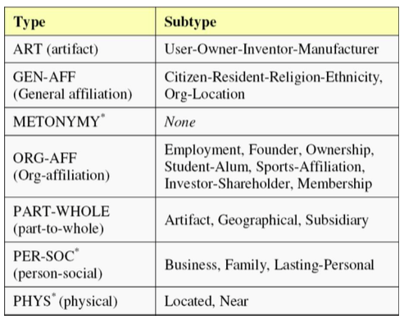
ACE 2008 Relations

Slide 26
Features
Light-weight
BOW, bigrams between, before and after
Stemmed versions
Entity types
Distance between entities
Medium-weight
Base-phrase chunk paths
Head words of chunks
Heavy-weight
Dependency, constituency tree paths
Tree distance
Patterns over trees

Slide 27
Features Example
American Airlines, a unit of AMR, immediately matched the move, spokesman Tim Wagner said.
employer(American Airlines, Tim Wagner)
Bag-of-words features
WM1 = {American, Airlines}, WM2 = {Tim, Wagner}
Head-word features
HM1 = Airlines, HM2 = Wagner, HM12 = Airlines+Wagner
Words in between
WB-NULL = false, WBF-L = NULL, WBF = a, WBL = spokesman,
WBO = {unit, of, AMR, immediately, matched, the, move}
Words before and after
BM1F = NULL, BM1L = NULL, AM2F = said, AM2L = NULL
Good precision (69%) but poor recall (24%).

Slide 28
Features: Base phrase Chunking
[NP American Airlines], [NP a unit] [PP of] [NP AMR], [ADVP immediately] [VP matched] [NP the move], [NP spokesman Tim Wagner] [VP said].
Phrase heads before and after
CPHBM1F = NULL, CPHBM1L = NULL, CPHAM2F = said, CPHAM2L = NULL
Phrase heads in between
CPHBNULL = false, CPHBFL = NULL, CPHBF = unit, CPHBL = move CPHBO = {of, AMR, immediately, matched}
Phrase label paths
CPP = [NP, PP, NP, ADVP, VP, NP] CPPH = NULL [A way to generalize!]
Increased both precision & recall by 4-6%

Slide 29
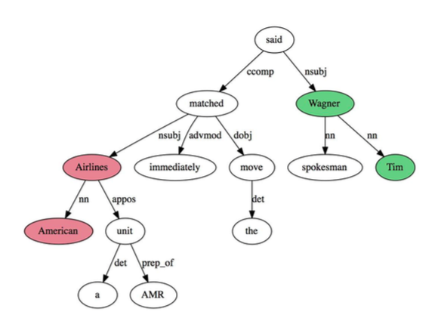
Features: Syntactic Parse
Mention dependencies
ET1DW1 = ORG:Airlines
H1DW1 = matched:Airlines
ET2DW2 = PER:Wagner
H2DW2 = said:Wagner
Entity types and dependency tree
ET12SameNP = ORG-PER-false ET12SamePP = ORG-PER-false ET12SameVP = ORG-PER-false
Minor gain in terms of results. Why?
1) Many relations are local.
2) Parse features are useful for long distance connections but parsers fail on long sentences.

Slide 30
Example: IE on Biomedical Corpora
AIMed: 750 abstracts that contain the word human were randomly chosen from Medline for testing protein name extraction. They were manually tagged by experts to annotate a total of 5,206 human protein references (Bunescu et al., 2005).

Slide 31
Relation Extraction
Biomedical corpora => Interactions between Proteins.
interaction
protein
protein
Cyclin D1 is induced in early G1 and becomes associated with p9Ckshs1, a Cdk binding subunit.
Newspaper corpora => relationships (e.g. Role, Part, Location, Near, Social) between predefined types of entities (e.g. Person, Organization, Facility, Location, Geo-Political).
location
location
people
facility
people
Protesters seized several pumping stations, holding 127 Shell workers hostage.

Slide 32
Relation Extraction as Classification
For a given relation, classify each pair of type-consistent entities that are in the same sentence as having that relation or not.
Location: Classify each pair of People and Facility.
??
??
location
location
people
facility
people
Protesters seized several pumping stations, holding 127 Shell workers hostage.

Slide 33
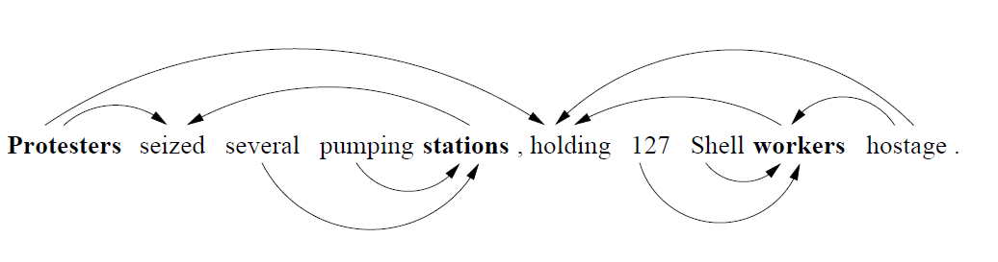
Sequence to Classify
Word sequence between the entities
Dependency path between the entities
??
??
location
location
people
facility
people
Protesters seized several pumping stations, holding 127 Shell workers hostage.

Slide 34
Evaluating IE Accuracy
Always evaluate performance on independent, manually-annotated test data not used during system development.
Measure for each test document:
Total number of correct extractions in the solution template: N
Total number of slot/value pairs extracted by the system: E
Number of extracted slot/value pairs that are correct (i.e. in the solution template): C
Compute average value of metrics adapted from IR:
Recall = C/N
Precision = C/E
F-Measure = Harmonic mean of recall and precision

Slide 35
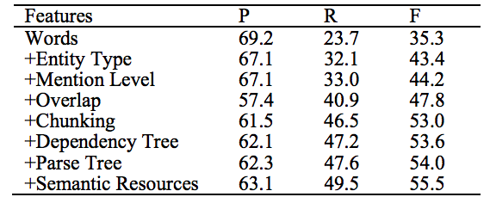
Evaluation
Relation detection performance is reasonable.
Relation classification is decent but not great.
Engineering features is better than letting ML figure out features
(for this task).

Slide 36
How is relation extraction done?
Pattern-based + Bootstrapping
Supervised Relation Extraction
Distantly Supervised Relation Extraction
Open Information Extraction
Event Extraction

Slide 37
Distant Supervision
Motivated by lack of training data.
Bootstrapping gets some additional “training” data at each round.
Use a large database to get huge of seed relations.
Find sentences that express these seed relations.
Assume that any sentence that contains both entities in relation is expressing the relation.
Train a supervised classifier

Slide 38
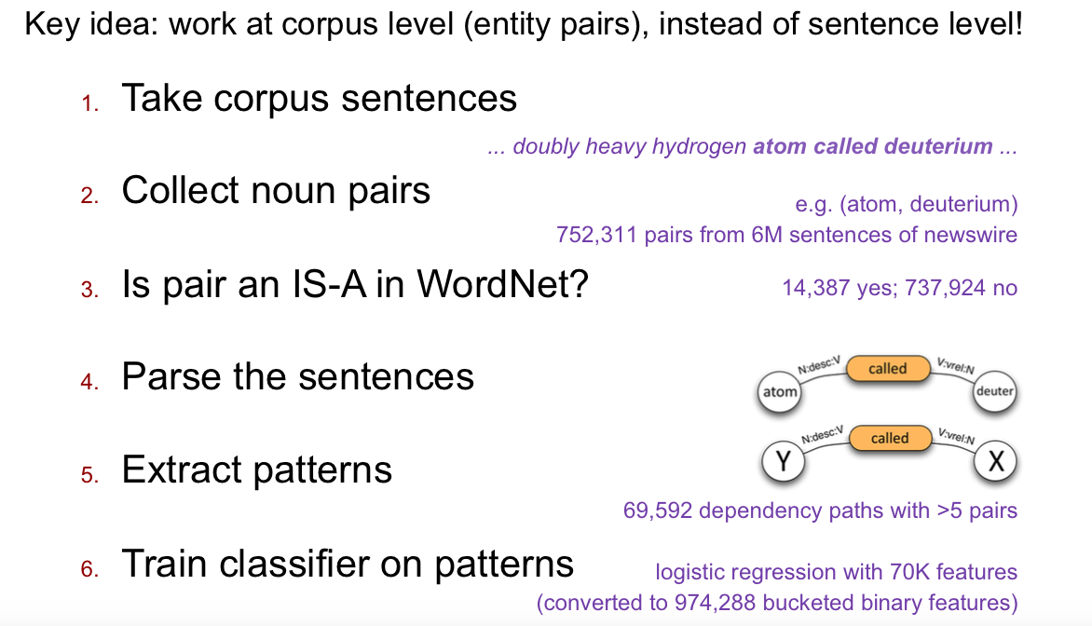
Hypernyms via Distant Supervision [Snow 2005]

Slide 39
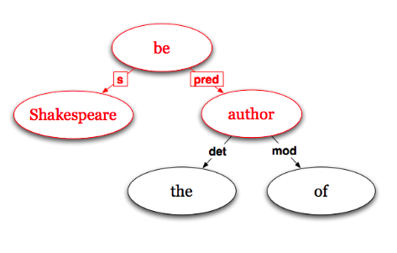
Lexico-syntactic Dependency Patterns
(Shakespeare, author) “Shakespeare was the author of several plays...”
Extract shortest path on the tree
<N:N, subj, VBE:be>, <be:VBE, pred, N:N>
Path is a ordered list of edge tuples:
Tuple = <word1:cat1, Rel, cat2:word2>
Entities generalized into POS category.

Slide 40
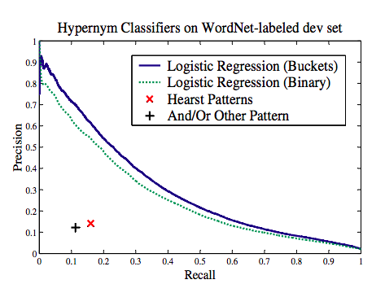
Evaluation

Slide 41
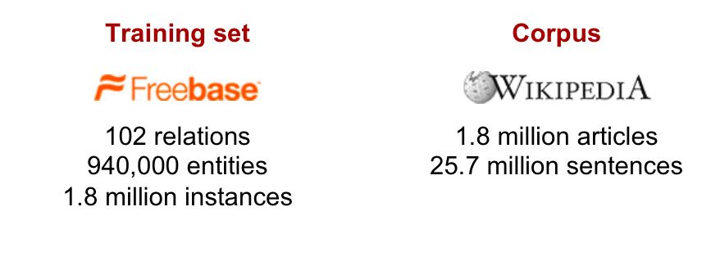
Distant Supervision for Freebase Relations [Mintz 2009]
Premise:
ACE relations are only a handful.
At large scale, training data is hard to create.
Large-ish databases of relations are available. Use them.

Slide 42
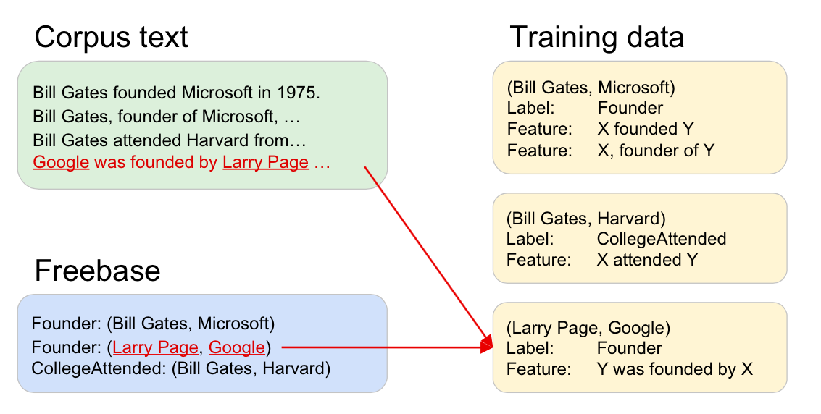
Distant Supervision for Freebase Relations

Slide 43
Distant Supervision for Freebase Relations
Training:
For each relation in Freebase: Find sentences that contain the entities in the relation.
Extract features from the sentence
Aggregate features, append relation name and we have an instance.
Learn a classifier over the training instances.
Relation Extractor:
For all sentences that contain any pair of (named) entities:
Extract features.
For every unique pair of entities:
Aggregate features and make a prediction.

Slide 44
Partial Information from Multiple Sentences
[Steven Spielberg]’s film [Saving Private Ryan] is loosely based on …
Evidence for [Saving Private Ryan] as a film.
Ambiguous evidence for Spielberg as a director.
… Award winning [Saving Private Ryan], directed by [Steven Spielberg]...
Ambiguous evidence for [Steven Spielberg] as a director. Could be a CEO.
No evidence for [Saving Private Ryan] as a film.

Slide 45
Negative Training Data?
If you only had positive data, you have to assume that anything that is not in your data is negative.
If we only have positive data, how do we know which features are bad?
Suppose you saw this sentence:
Google is Bill Gates' worst fear said its CEO.
And learnt this pattern:
Y is X’s worst fear => CEO-of(X, Y)
Solution?
Sample 1% of unrelated pairs of entities.

Slide 46
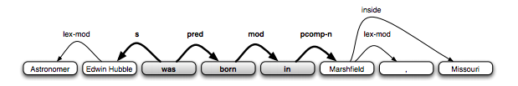
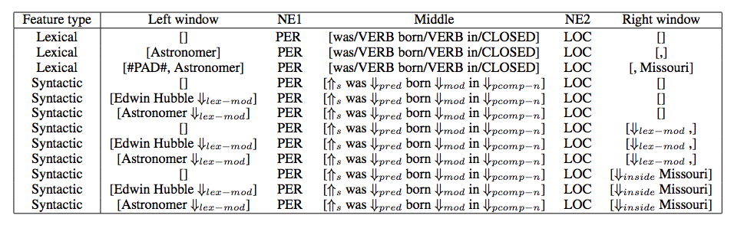
Features
‘Astronomer Edwin Hubble was born in Marshfield, Missouri’

Slide 47
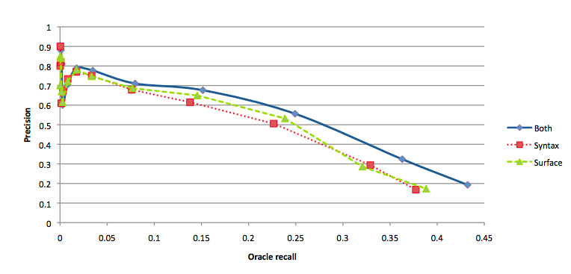
Evaluation
Evaluation:
Select the top 102 relations with most entries.
Use half for training and other half for testing.
Combining syntax and surface helps over either.

Slide 48
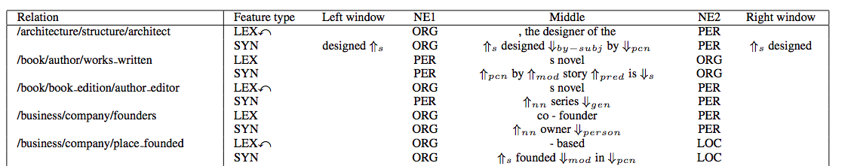
Top Weighted Features

Slide 49
Issues with Distant Supervision
False positives
Some entities may have multiple relations.
lives-in(Obama, Washington DC)
works-in(Obama, Washington DC)
Presence of entities alone doesn’t guarantee relation is expressed
“Microsoft is catching up.”, Bill Gates said.
False negatives
Knowledge bases are incomplete.
System may correctly predict a relation which currently is not in KB.

Slide 50
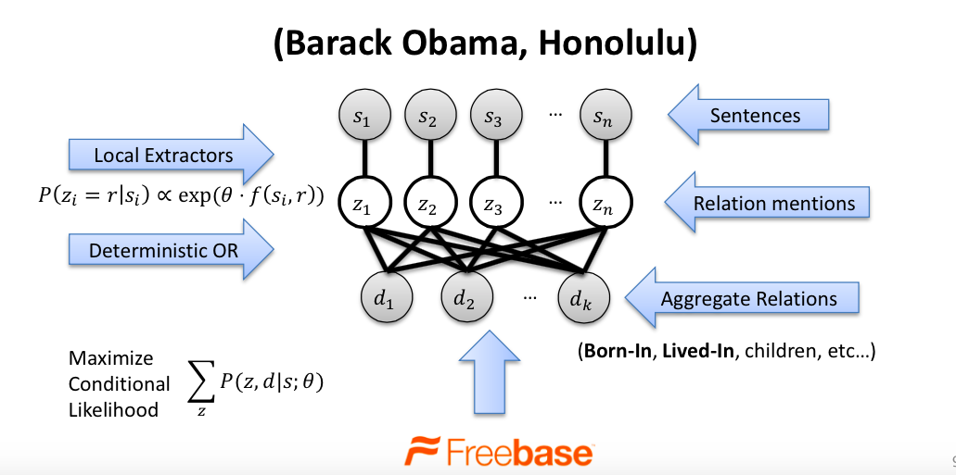
Multi-R [Hoffman et al, 2011]
Addresses the overlapping relations problem.

Slide 51
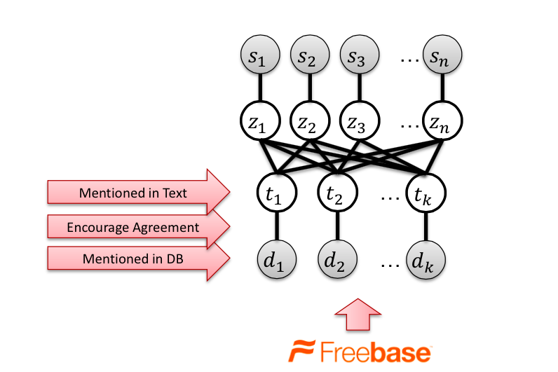
Missing Data [Ritter et al, 2013]
Addresses incomplete KB by treating facts as soft constraints.

Slide 52
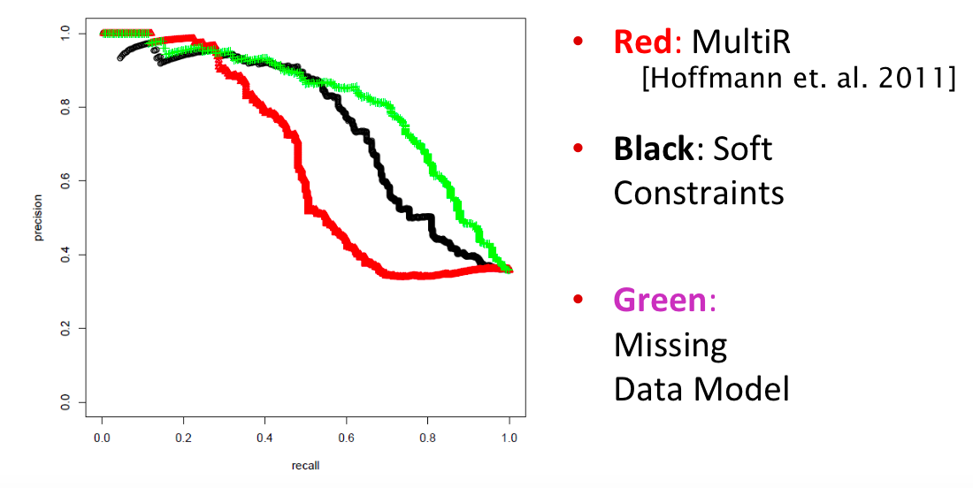
Multi-R + Missing Data

Slide 53
MUC
DARPA funded significant efforts in IE in the early to mid 1990’s.
Message Understanding Conference (MUC) was an annual event/competition where results were presented.
Focused on extracting information from news articles:
Terrorist events
Industrial joint ventures
Company management changes
Information extraction of particular interest to the intelligence community (CIA, NSA).
Established standard evaluation methodolgy using development (training) and test data and metrics: precision, recall, F-measure.

Slide 54
Medline Corpus
TI - Two potentially oncogenic cyclins, cyclin A and cyclin D1, share common properties of subunit configuration, tyrosine phosphorylation and physical association with the Rb protein
AB - Originally identified as a ‘mitotic cyclin’, cyclin A exhibits properties of growth factor sensitivity, susceptibility to viral subversion and association with a tumor-suppressor protein, properties which are indicative of an S-phase-promoting factor (SPF) as well as a candidate proto-oncogene …
Moreover, cyclin D1 was found to be phosphorylated on tyrosine residues in vivo and, like cyclin A, was readily phosphorylated by pp60c-src in vitro.
In synchronized human osteosarcoma cells, cyclin D1 is induced in early G1 and becomes associated with p9Ckshs1, a Cdk-binding subunit.
Immunoprecipitation experiments with human osteosarcoma cells and Ewing’s sarcoma cells demonstrated that cyclin D1 is associated with both p34cdc2 and p33cdk2, and that cyclin D1 immune complexes exhibit appreciable histone H1 kinase activity …

Slide 55
Medline Corpus: Named Entity Recognition (Proteins)
TI - Two potentially oncogenic cyclins, cyclin A and cyclin D1, share common properties of subunit configuration, tyrosine phosphorylation and physical association with the Rb protein
AB - Originally identified as a ‘mitotic cyclin’, cyclin A exhibits properties of growth factor sensitivity, susceptibility to viral subversion and association with a tumor-suppressor protein, properties which are indicative of an S-phase-promoting factor (SPF) as well as a candidate proto-oncogene …
Moreover, cyclin D1 was found to be phosphorylated on tyrosine residues in vivo and, like cyclin A, was readily phosphorylated by pp60c-src in vitro.
In synchronized human osteosarcoma cells, cyclin D1 is induced in early G1 and becomes associated with p9Ckshs1, a Cdk-binding subunit.
Immunoprecipitation experiments with human osteosarcoma cells and Ewing’s sarcoma cells demonstrated that cyclin D1 is associated with both p34cdc2 and p33cdk2, and that cyclin D1 immune complexes exhibit appreciable histone H1 kinase activity …

Slide 56
Medline Corpus: Relation Extraction Protein Interactions
TI - Two potentially oncogenic cyclins, cyclin A and cyclin D1, share common properties of subunit configuration, tyrosine phosphorylation and physical association with the Rb protein
AB - Originally identified as a ‘mitotic cyclin’, cyclin A exhibits properties of growth factor sensitivity, susceptibility to viral subversion and association with a tumor-suppressor protein, properties which are indicative of an S-phase-promoting factor (SPF) as well as a candidate proto-oncogene …
Moreover, cyclin D1 was found to be phosphorylated on tyrosine residues in vivo and, like cyclin A, was readily phosphorylated by pp60c-src in vitro.
In synchronized human osteosarcoma cells, cyclin D1 is induced in early G1 and becomes associated with p9Ckshs1, a Cdk-binding subunit.
Immunoprecipitation experiments with human osteosarcoma cells and Ewing’s sarcoma cells demonstrated that cyclin D1 is associated with both p34cdc2 and p33cdk2, and that cyclin D1 immune complexes exhibit appreciable histone H1 kinase activity …

Slide 57
Web Extraction
Many web pages are generated automatically from an underlying database.
Therefore, the HTML structure of pages is fairly specific and regular (semi-structured).
However, output is intended for human consumption, not machine interpretation.
An IE system for such generated pages allows the web site to be viewed as a structured database.
An extractor for a semi-structured web site is sometimes referred to as a wrapper.
Process of extracting from such pages is sometimes referred to as screen scraping.

Slide 58
Amazon Book Description
….
</td></tr>
</table>
<b class="sans">The Age of Spiritual Machines : When Computers Exceed Human Intelligence</b><br>
<font face=verdana,arial,helvetica size=-1>
by <a href="/exec/obidos/search-handle-url/index=books&field-author=
Kurzweil%2C%20Ray/002-6235079-4593641">
Ray Kurzweil</a><br>
</font>
<br>
<a href="http://images.amazon.com/images/P/0140282025.01.LZZZZZZZ.jpg">
<img src="http://images.amazon.com/images/P/0140282025.01.MZZZZZZZ.gif" width=90
height=140 align=left border=0></a>
<font face=verdana,arial,helvetica size=-1>
<span class="small">
<span class="small">
<b>List Price:</b> <span class=listprice>$14.95</span><br>
<b>Our Price: <font color=#990000>$11.96</font></b><br>
<b>You Save:</b> <font color=#990000><b>$2.99 </b>
(20%)</font><br>
</span>
<p> <br>
….
</td></tr>
</table>
<b class="sans">The Age of Spiritual Machines : When Computers Exceed Human Intelligence</b><br>
<font face=verdana,arial,helvetica size=-1>
by <a href="/exec/obidos/search-handle-url/index=books&field-author=
Kurzweil%2C%20Ray/002-6235079-4593641">
Ray Kurzweil</a><br>
</font>
<br>
<a href="http://images.amazon.com/images/P/0140282025.01.LZZZZZZZ.jpg">
<img src="http://images.amazon.com/images/P/0140282025.01.MZZZZZZZ.gif" width=90
height=140 align=left border=0></a>
<font face=verdana,arial,helvetica size=-1>
<span class="small">
<span class="small">
<b>List Price:</b> <span class=listprice>$14.95</span><br>
<b>Our Price: <font color=#990000>$11.96</font></b><br>
<b>You Save:</b> <font color=#990000><b>$2.99 </b>
(20%)</font><br>
</span>
<p> <br>…

Slide 59
Extracted Book Template
Title: The Age of Spiritual Machines :
When Computers Exceed Human Intelligence
Author: Ray Kurzweil
List-Price: $14.95
Price: $11.96
:
:

Slide 60
Evaluating IE Accuracy
Always evaluate performance on independent, manually-annotated test data not used during system development.
Measure for each test document:
Total number of correct extractions in the solution template: N
Total number of slot/value pairs extracted by the system: E
Number of extracted slot/value pairs that are correct (i.e. in the solution template): C
Compute average value of metrics adapted from IR:
Recall = C/N
Precision = C/E
F-Measure = Harmonic mean of recall and precision

Slide 61
Open Information Extraction
Unsupervised approach to extraction in which the set of relations to extract are not predefined.
Use dependency parses to extract specific lexical relations between entities and cluster these paths to define an ontology of extracted relations.

